Slide 1
Lecture Three
The intersection of space and cyber

Slide 2
Class Day 2
0900 - 0945 Lecture 3: 45m Recap, Intersection of Space and Cyber
0945 – 1030 Lab 5: 45m Command Interceptor
1030 Break: 15m
1045 – 1115 Lecture 4: 30m The Future
1115 – 1215 Lab 6: 1hr cloaking device
1230 – 1345 Lunch
1400 – 1445 Lecture 5: 45m SPARTA
1445 – 11545 Lab 7: 1hr : Code Execution
1600 - Break: 15m
1615 – 1645: Lecture 6: 30m State of things
1645 - 1800 FFA lab time: 75m Go ahead and break it all, we will re-deploy tomorrow!

Slide 3

Recapping Yesterday’s labs
Spinning a satellite around
Real speed of movement vs what you saw in 42
Slew rate, what it means and why
Slewing while pointing at ground for communications
Slewing while pointed at space to observe same target
JWST ~ 3 degrees per minute (this is slow)
Slewing to observe a weapon
Slewing implications
Antenna sheer
Loss of control
Damage to attitude control (actuators, fly wheels etc)

Slide 4
Recapping Yesterday’s labs: Comms, DoS encryption etc
So if I can point my antenna at a satellite and talk to it….?
You would have to know the frequency and other RF related details to close the link
You would have to know the radio salutation context
This prevents DoS
This prevents battery taxing
You would have to have the encryption if it exists
You would have to know the way the satellite takes tasks (packet construction / where file monitoring looks for things

Slide 5
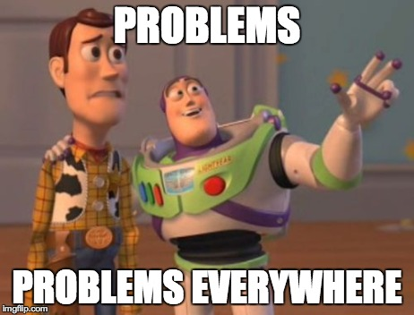

Slide 6
The Cost Problem
Lack of cost metric for cybersecurity in general
Obsession with flight heritage
Can’t make informed risk acceptance decisions
Will default to risk acceptance (plenty of flight heritage for accepting risk, for cyber not so much)
Mesh complications
Cost communication becomes more convoluted
Fixes and attacks can proliferate faster

Slide 7

The Culture Problem
The Hayabusa story
Usually, cybersecurity people are the most risk averse
Normally cybersecurity people are the more technical people in the cybersecurity discussion
The space industry is obsessed with risk
The technical perspectives of people in the industry can complicate telling the cybersecurity story

Slide 8
Supply Chain Problem(s)
Few proven vendors for buses, antennas, FPGAs and other significant components
Exceptional targetability for interdiction
High probability of widespread industry disruption if a vendor has an issue
Few proven launch providers
The threat of time
Launch windows
Long lead parts

Slide 9

Disparity Problem(s)
Space Rated Cyber: Disparity in Defense Vs Offense
Even if resources, capabilities and numbers were the same:
Defensive capabilities must be space rated
System owners will see defensive tools as a threat to their mission
Defensive tools must fail open (lest they be weaponized)
Specialization and limited supply chain and vendors allow attackers to hyper-focus on specific attack surface
Lack of defense in depth

Slide 10
3rd Party Attack Surface Problem
Beyond SV resident code execution, an ability to impact a space system stretches far beyond the control of owners and operators
Widely varied, targetable environmental testing facilities
Vacuum chambers
Anechoic chambers
Vibration tables, etc.
Storage and transport for tests and launch
Intra-vehicle tenants & operators

Slide 11
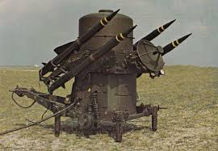
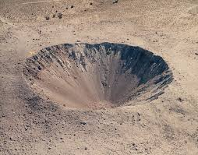
The Cyber Warfare Problem
Suitability

Slide 12
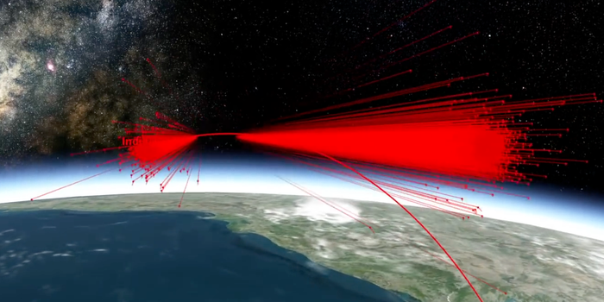
Kinetic Anti-Satellite Weapons
Mission Shakti, Indian anti-satellite test
1600 lb. satellite turned into 6500+ pieces of shrapnel going 22,000 MPH+
Debris field 175 miles above earth
A simulation of space debris created by India's "Mission Shakti" anti-satellite missile test on March 27, 2019. Analytical Graphics Inc.

Slide 13
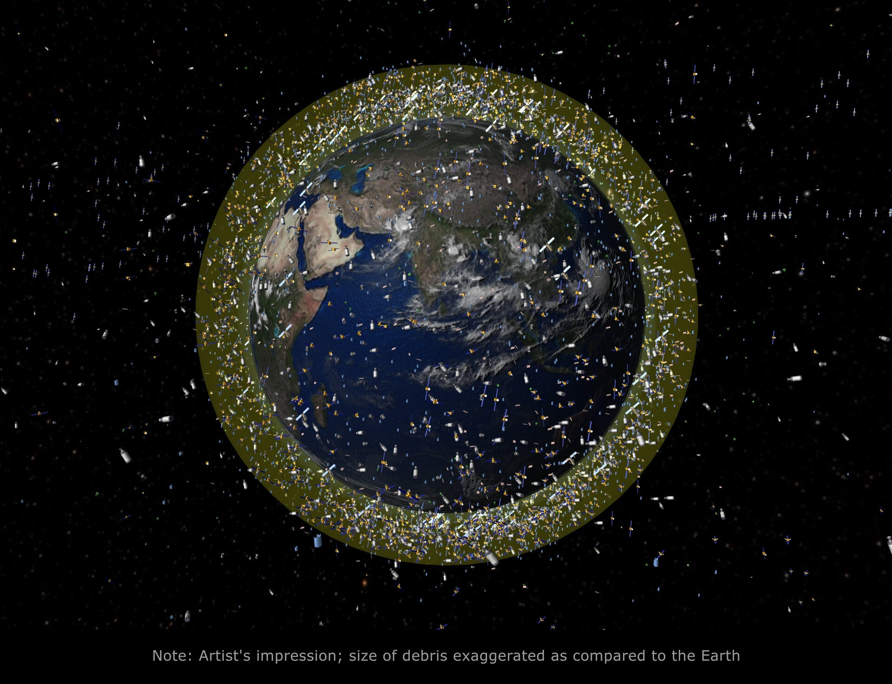
Kessler Effect
One event could cascade into more, polluting entire orbital areas
SpaceX alone at 5,000+ already
Launches accelerating
More space objects = worse curve for Kessler Effect

Slide 14
The Test & Evaluation Problem
RMF and IV&V is validation and evaluation not exercise of security apparatus
All other tests for space systems exercise
Torque bolt measurement vibe test analogy

Slide 15
The Adaptation Problem
All non-cyber challenges are solvable and can be evaluated / exercised in repeatable defensible manners
Cyber threat is constantly undermining preventative measures and extremely difficult to defensibly evaluate implementations.

Slide 16
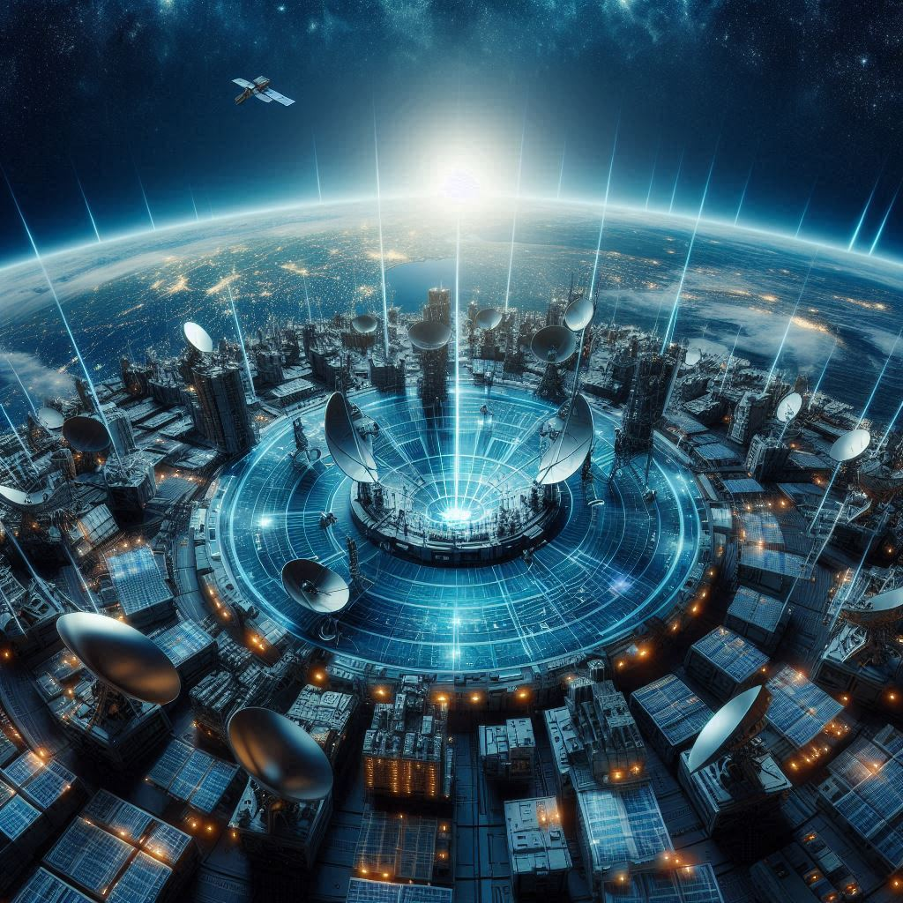
The Defense In Depth Problem
Components and systems are too trusting
Communications within space system too trusted (all encrypted so everything is fine right?)
Ground to vehicle
Vehicle to vehicle
Vehicle to ground
Computationally intensive defenses end at ground station, if present there at all

Slide 17
The Modernization Problem
Transition to more common OS for portability and resources must be done correctly
Not just for developmental and integration ease but also leverage that technology’s security features
Other wise attack surface is worse off going from a one off unknown old piece of software to a well understood and unsecure modern one

Slide 18
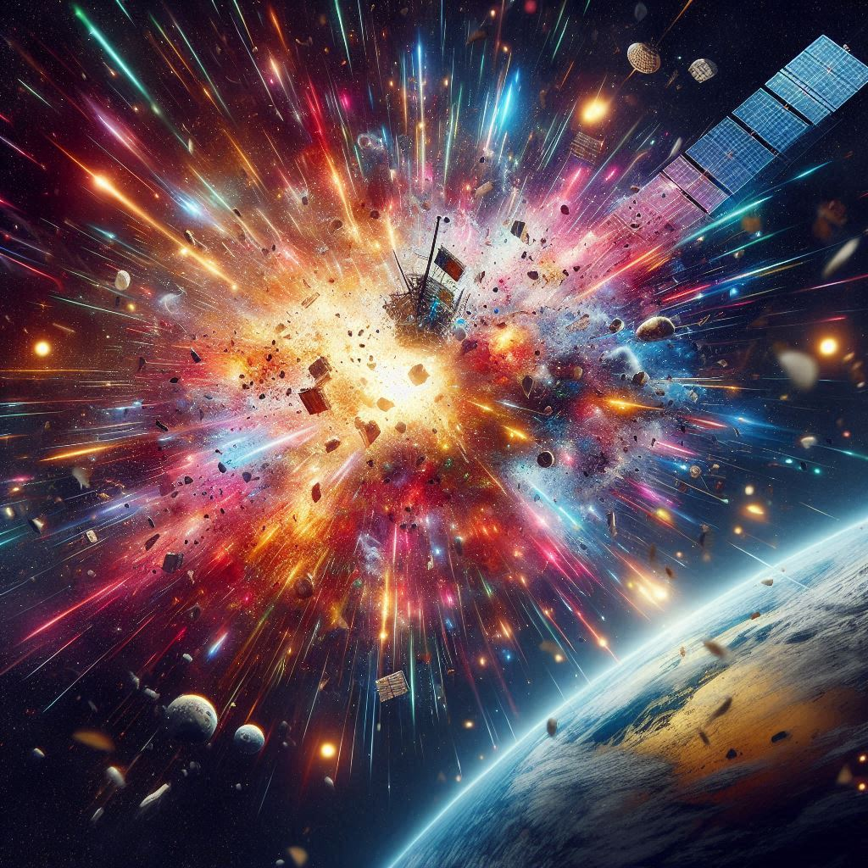
The Failure Analysis Problem
Software definition of space system functions will continue
Anomaly or failure on a space vehicle might have been intentionally caused by a cyber effect needs
Cyber attacks need to be explored as a cause during failure analysis in tandem with or in high priority amongst other potential root causes

Slide 19
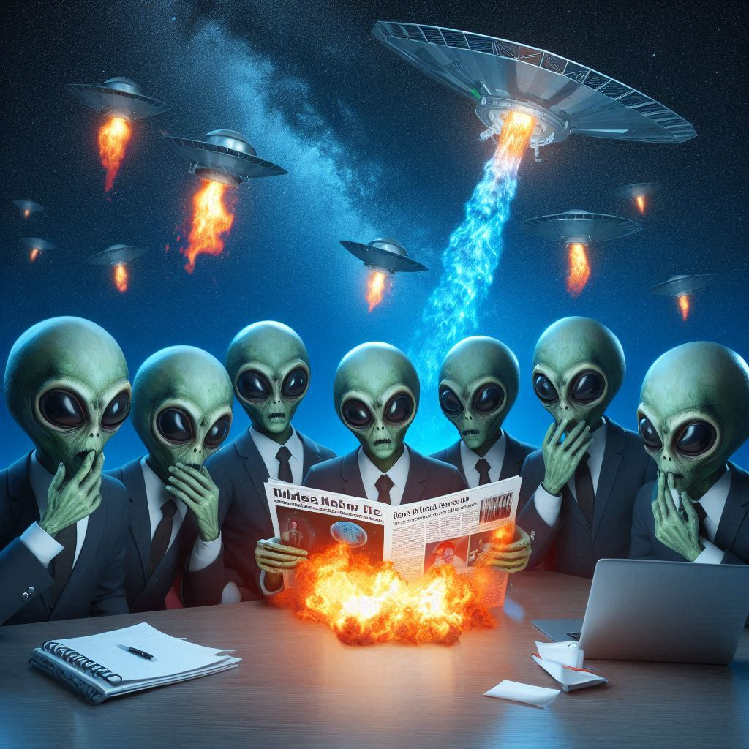
The Disclosure Problem
Most of these systems are owned or utilized by governments and militaries who are not required to, or have it in their best interest, to disclose compromises or vulnerabilities
This impacts the ability to do effective heuristic detection with large sample sets, giving a leg up to the adversary

Slide 20
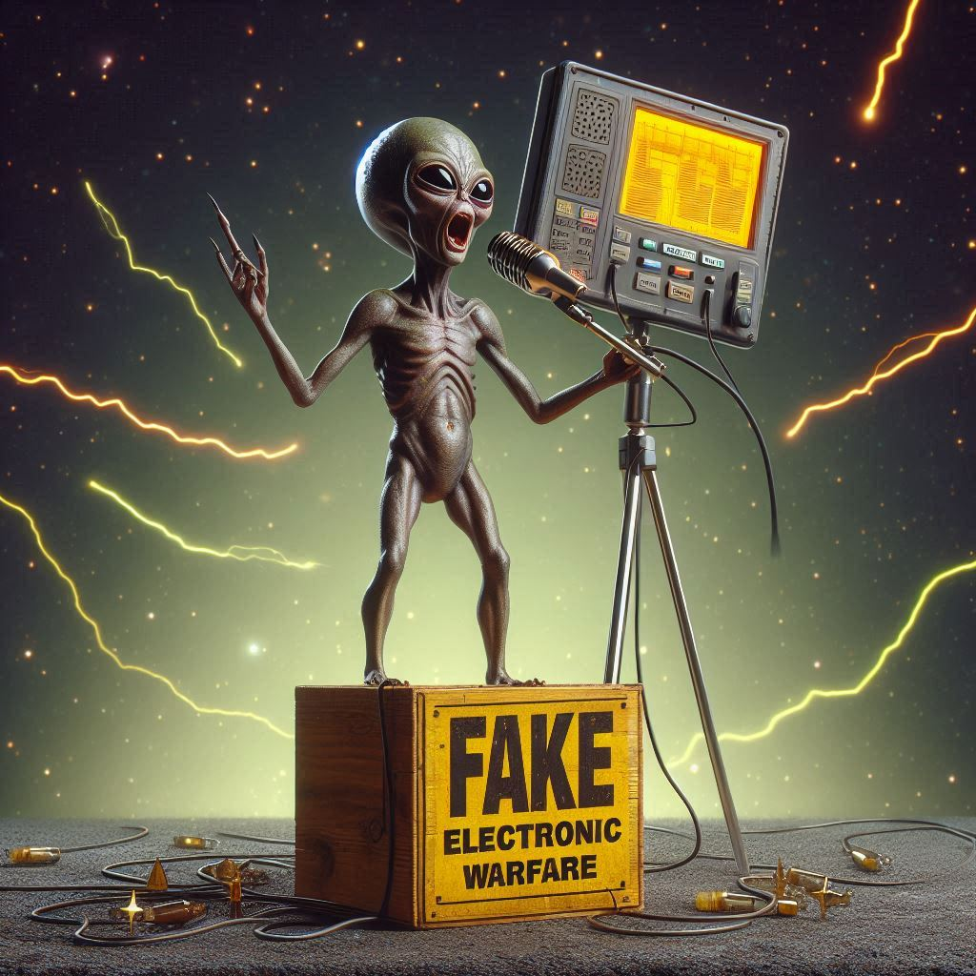
Electronic Warfare
Jamming
Spoofing
Importance of separating from cyber threats
Is this cyber? Is this a cybersecurity problem?
Why is it problematic to too closely associate the two
From a defensive perspective
From an offensive perspective

Slide 21
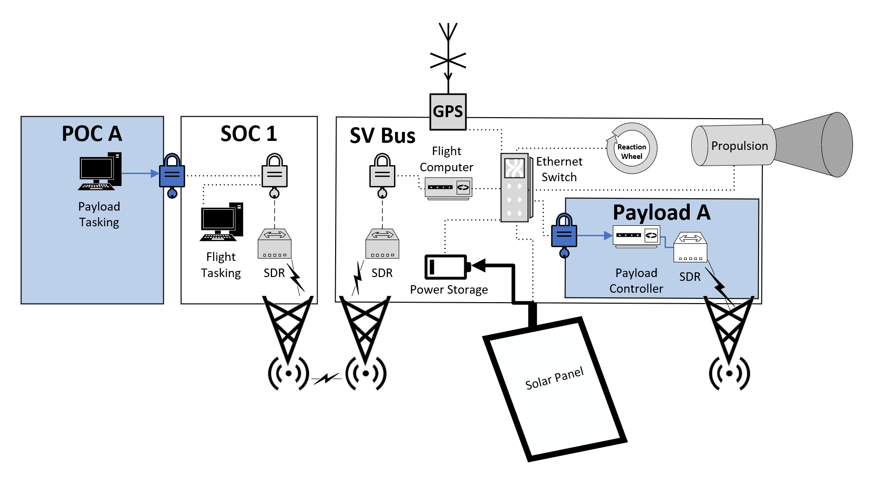
Organic Attack Surface

Slide 22
2nd Party Attack Surface
Hosted Payloads scenario
Satellite Operator(s)
Payload Operator(s)

Slide 23
3rd Party Attack Surface
Beyond SV resident code execution, an ability to impact a space system stretches far beyond the control of owners and operators
Widely varied, targetable environmental testing facilities
Vacuum chambers
Anechoic chambers
Vibration tables, etc.
Storage and transport for tests and launch
Intra-vehicle tenants & operators

Slide 24
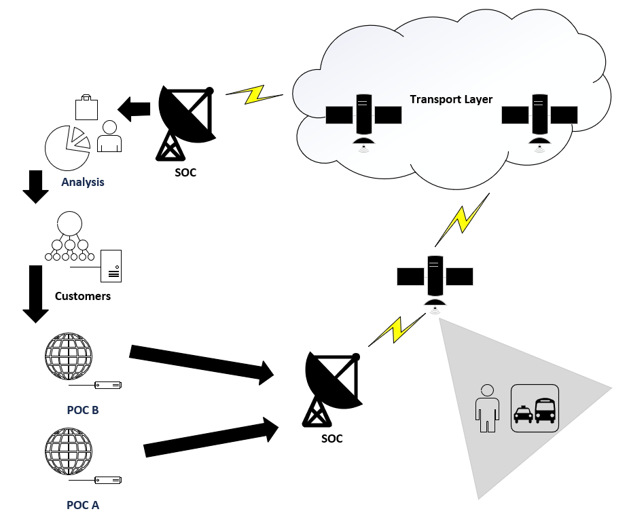
Architecture

Slide 25
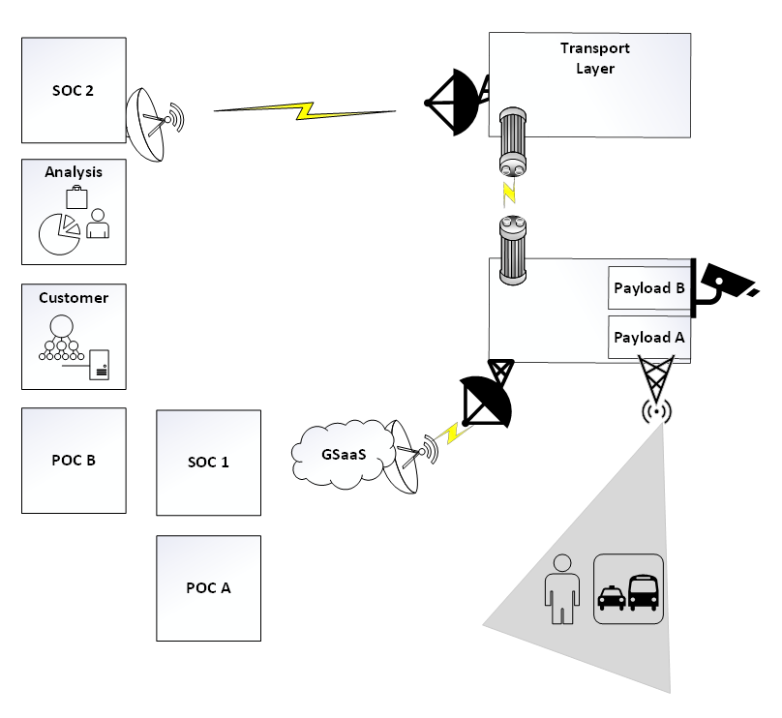

Slide 26
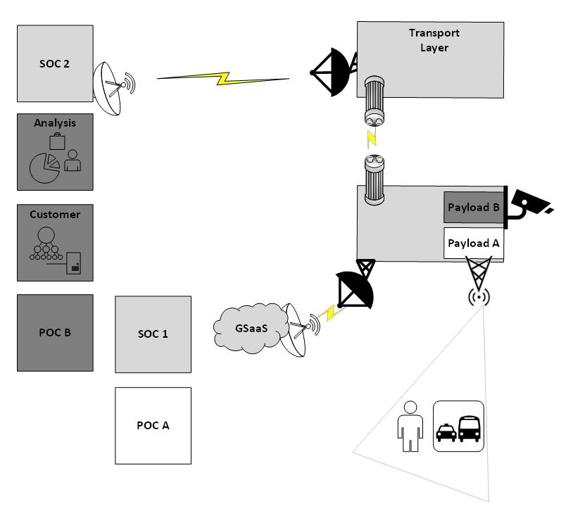

Slide 27
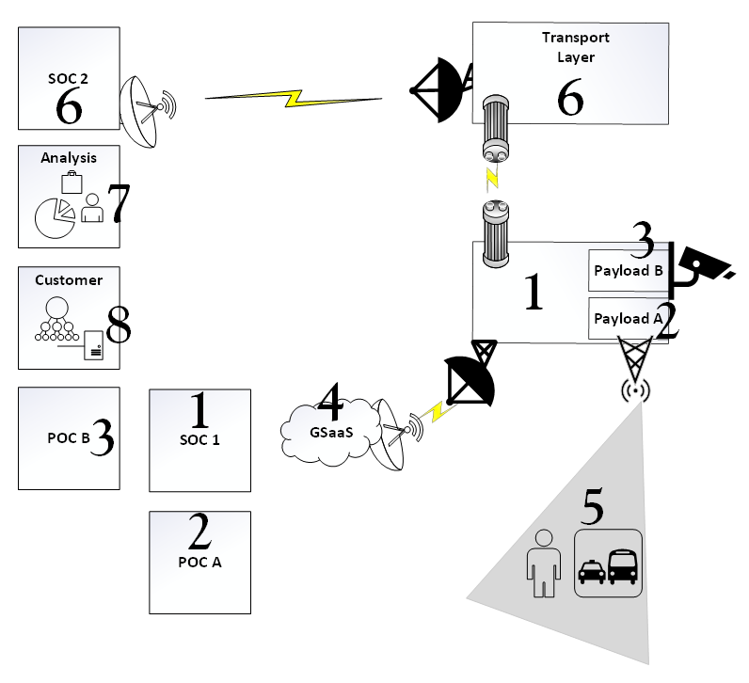
SOC 1 and the satellite Bus are owned by a company offering payload hosting.
POC A and Payload A are owned by a broadcast radio company
POC B and Payload B are owned by a imaging company that takes sensitive images as a service
GSaaS provided by a 3rd party commercial organization.
Users of satellite radio are another customer.
The transport layer SOC 2 and its satellites are owned by a different commercial organization.
Analysis of the images is a different organization.

Slide 28

Space

Slide 29

Scary Story Time
You stole the satellite(s)?
Admittedly (hopefully) oversimplified example:
Task an update to the satellite(s) that replaces encryption keys
Start talking to your new satellite from your own ground station(s)
But….that’s not realistic right?.......Right?

Slide 30
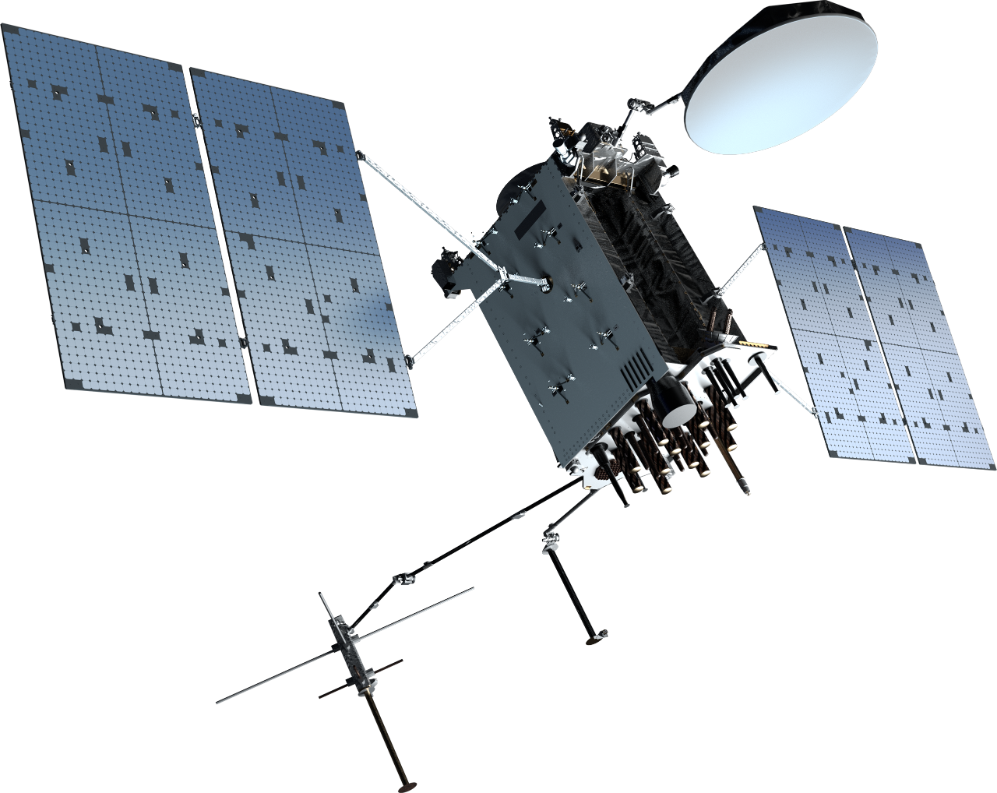
Money Talks (and so does national security)
Single Lockheed Martin GPS 3F satellite ~$250M
https://spacenews.com/u-s-space-force-buys-three-new-gps-satellites-from-lockheed-martin/
GPS constellation: Lockheed Martin is now producing a more advanced version, the GPS 3F. The company in 2018 was awarded a contract worth $7.2 billion for up to 22 GPS 3F satellites.
https://spacenews.com/air-force-to-award-7-2-billion-contract-to-lockheed-martin-for-22-gps-satellites/
GPS over time: “Reports estimate that since the 1980s, GPS satellites have helped generate nearly $1.4 trillion in economic benefits”
https://aerospace.org/article/brief-history-gps

Slide 31

Let’s run some numbers
2023: US servicemember with clearance passes detailed classified technical manuals and documents to foreign Intelligence for $5,000.
2024: US servicemember with clearance enters restricted compounds to take information and pass along to foreign intelligence for $15,000
2024: US servicemember with top secret clearance downloads and sells to foreign intelligence for $42,000
What do we think a foreign government would be willing to pay to instantly own the GPS constellation? A million? Ten million? A billion?
Also, we’d then just shoot them down, right? No. Remember, you’d pollute the orbit with hypersonic shrapnel.

Slide 32
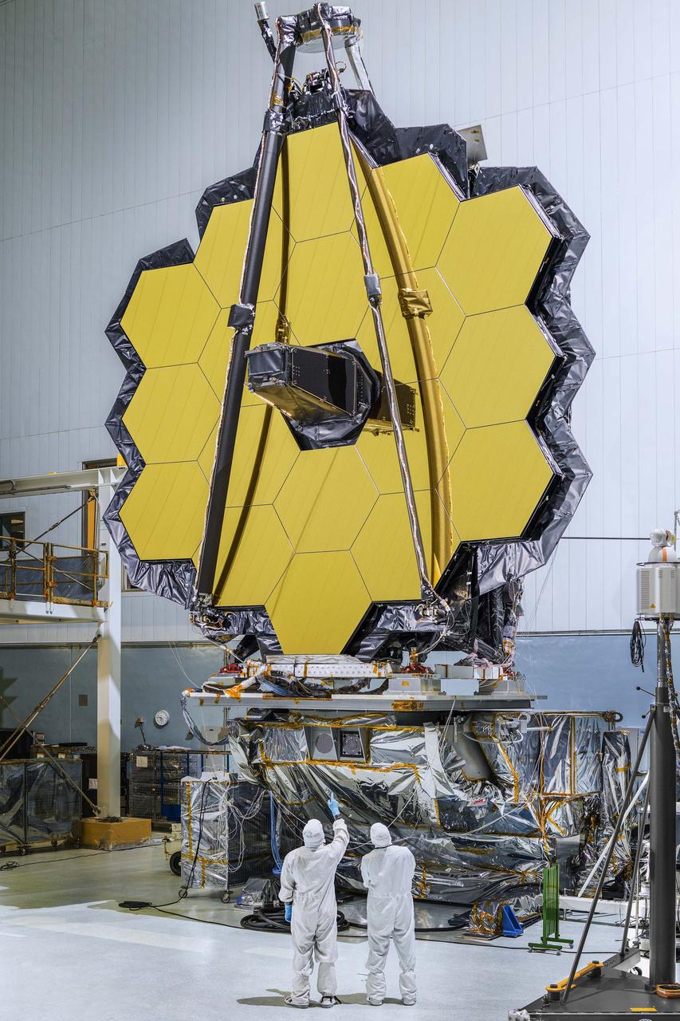
Not convinced? How about a softer target?
James Webb Space Telescope (JWST)
Cost: $10 Billion
https://www.space.com/21925-james-webb-space-telescope-jwst.html
Really big infrared sensor
Same questions apply.

Slide 33
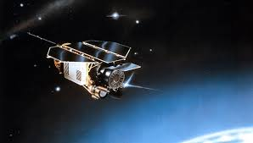
RoSat
In 1998 a joint German / US X-ray sensor satellite called ROSAT was compromised.
Allegedly involved a foreign actor gaining access to Goddard Space Flight Center via social engineering and poorly configured FTP services.
Ultimately the actor was able to access a server that contained RoSat mission files. Algorithms were changed in those files that resulted in the satellite pointing towards the sun and overheating.
The team was able to identify the issue and correct the satellites positioning but without knowing it was the result of cyber activity.
Later it appears the actor came back, this time pointing the imager directly at the sun and permanently damaging it.

Slide 34
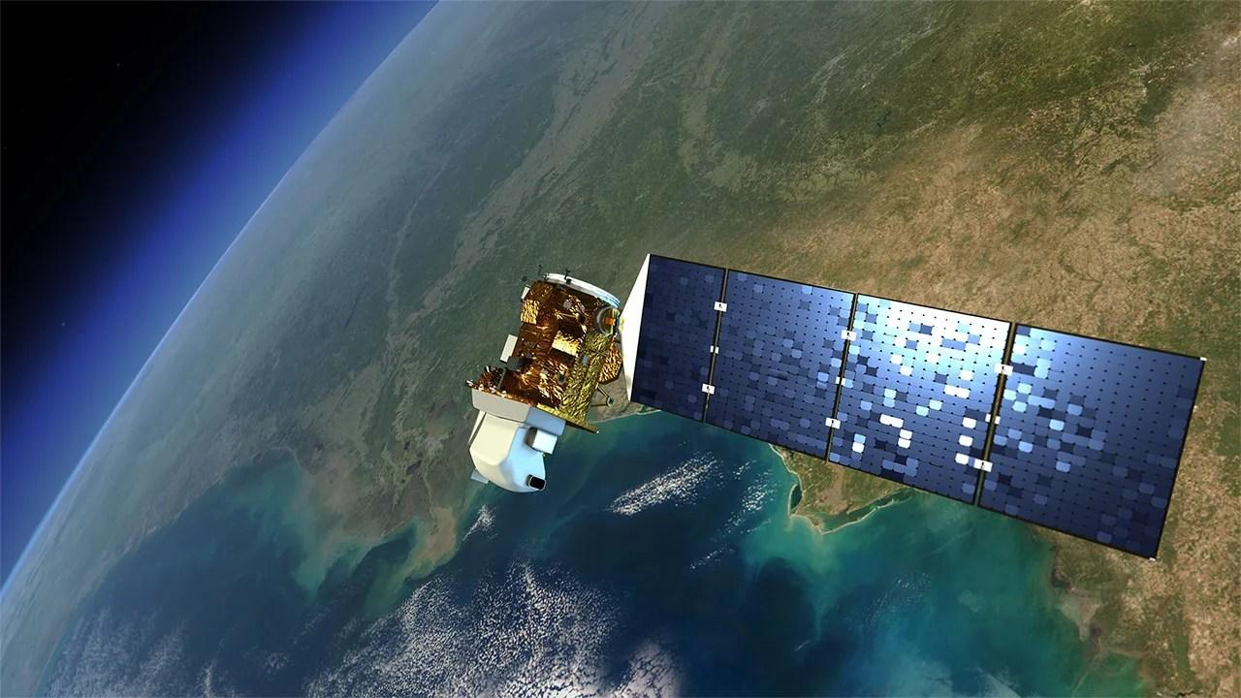
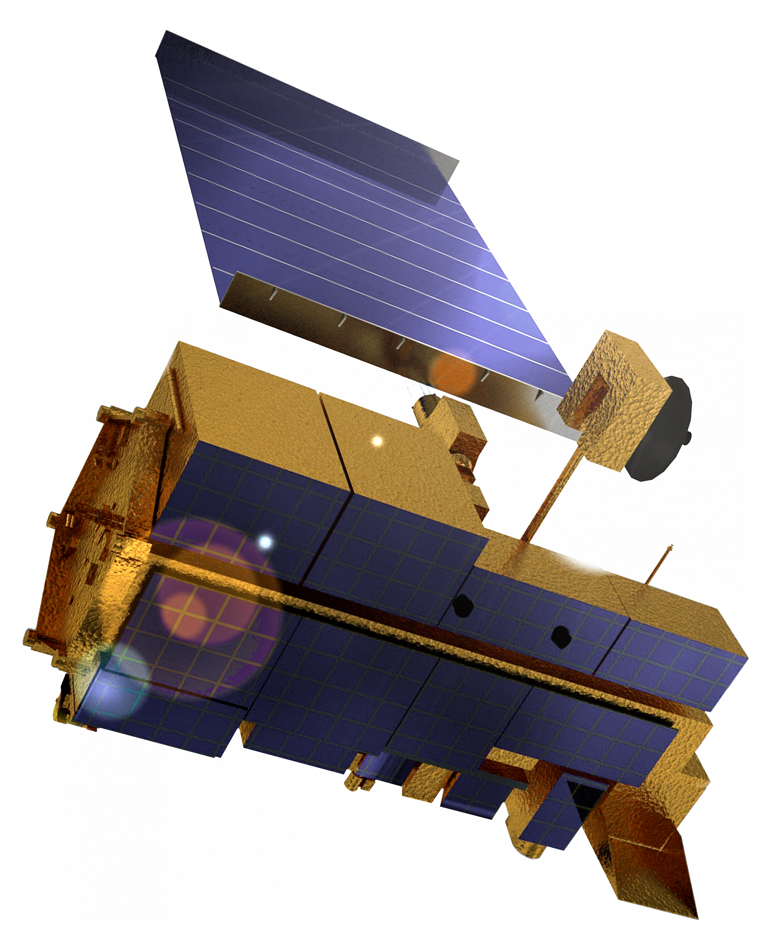
Landsat / Terra Sat
October 2007 and July 2008, NASA-managed Landsat-7 satellite experienced 12 or more minutes of interference
June and October 2008, Terra AM-1 satellite was disrupted for two minutes and nine minutes respectively
The malicious activity was tied to a compromised ground station in Norway via local internet
According to NASA the hackers had the full ability to send legitimate command and control tasking to the satellites from the compromised ground station

Slide 35
That disclosure problem…
Skynet
Allegedly, a GROUP of computer hackers suspected of seizing control of a British military communications satellite using a home computer, triggering a "frenetic" security alert, has been traced to the south of England.
Allegedly, a security source said that, up to a month ago, the hackers found a "cute way" into the control system for one of the Ministry of Defence's Skynet satellites and "changed the characteristics of channels used to convey military communications, satellite television and telephone calls".
Allegedly, the facts as reported are as follows: Two weeks ago, British aerospace authorities noticed an irregularity in the position of one of their satellites, a military communications satellite belonging to a group of four known as Skynet satellites. Shortly thereafter, they received an anonymous message demanding money in exchange for control over the satellites guidance systems. "This is a nightmare scenario," an "intelligence source" told Reuters. "This is not just a case of computer nerds mucking about," said another. "This is very, very serious and the blackmail threat has made it even more serious.“
NOAA
2014 compromise of multiple aspects of their weather networks including space systems
Delayed reporting the breach and declined to comment on the extent of impacts of the compromise

Slide 36
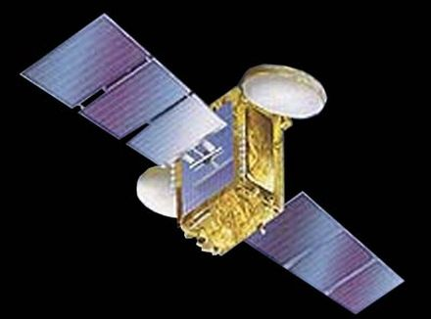
But…….INSAT-4B Happened
Credit to Jeffrey Carr and his Forbes article:
On July 7, 2010, a power glitch in the solar panels of India's INSAT-4B satellite resulted in 12 of its 24 transponders shutting down
India's Space Research Organization was a Siemens customer
According to the resumes of two former engineers who worked at the ISRO's Liquid Propulsion Systems Centre, the Siemens software in use is Siemens S7-400 PLC and SIMATIC WinCC, both of which will activate the Stuxnet worm.
https://www.forbes.com/sites/firewall/2010/09/29/did-the-stuxnet-worm-kill-indias-insat-4b-satellite/?sh=2618bb7a127d
Regardless of conjecture and intended purpose, is proof that a state cyber campaign could effectively target space assets. Also, only example of true malicious code execution.

Slide 37
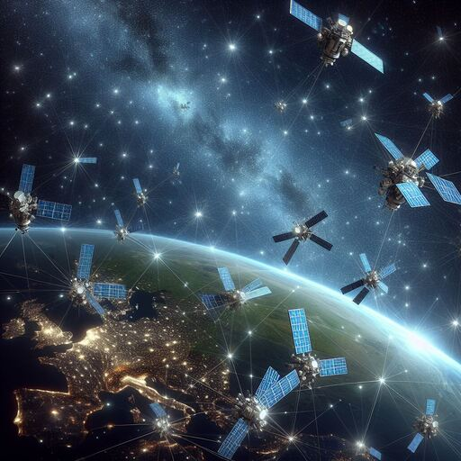
Constellations and Meshes: Mitigation or Risk?
Pros
Additional satellites can improve resilience
Mesh network makes communications and tasking more resilient
Persistence more easily achieved
Less ground infrastructure
Cons
Aggregation of risk
Enemy needs less infrastructure on the ground
Attacks can spread more quicky and have higher payoff

Slide 38

The Expectation of Protection
Realistic:
Borders
Airspace
National Waters
Unrealistic:
Cyber
Space

Slide 39
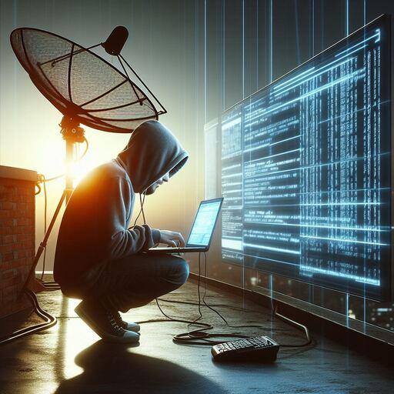
The Age of Space Conflict Asymmetry
WHAT WAS: Near peer adversaries capable of spaceflight contesting dominance of the space domain
WHAT IS: Anyone with a laptop and access to the internet has an ability to participate

